Slide 1
Parent Forum
Good afternoon!
Help yourself to refreshments

Slide 2
Our priorities
1. Improve leadership, management and governance of the school by ensuring that: Subject leaders receive the necessary training and time to develop their leadership skills and to monitor the quality of teaching effectively Leaders at all levels, including governors, embed those strategies that they have already put into place to ensure that teachers' assessment of pupils' achievement is accurate There are increased opportunities both within mathematics lessons and the wider curriculum for pupils to develop their mathematical skills, particularly their problem solving and reasoning skills
2. Improve the quality of teaching and the progress made by all pupils, by ensuring that: Assessment information is used effectively when planning pupils' future learning Consistently set activities provide sufficient support and challenge for all pupils, particularly the middle-attaining pupils and the most able to enable them to make at least the progress they should Staff can quickly clarify any misconceptions that pupils may demonstrate in their learning, so that pupils become secure in their knowledge, skills and understanding
3. Raise pupil attainment throughout the school by ensuring that: All assessment data is accurate based on standardised tests, internal tracking and moderation of age related expectations The curriculum is fit for purpose and provides opportunities to use and apply key skills within R, W and M The gap for all pupils between School and National is diminished in all areas for all groups, in particular EYFS, maths whole school and KS1 writing
4. Improve pupils’ personal development, behaviour and welfare by: Working closely with parents to develop and sustain strong relationships, as partners in learning, ensuring attendance and punctuality improves, especially those who are persistently absent Increasing expectations of pupil behaviour in line with school policy and supporting those pupils who require help to develop better self-regulation and management Agreed behaviours for learning are consistently embedded across the school

Slide 3
Purpose
The parent forum aims to represent the views of all parents and to be a voice to inform our school of the needs of children and families.
It facilitates communication between parents/carers and staff and governors.
The forum works to provide feedback on provision, offer a parent's perspective on current policy and practice and input into decision making and planning for future provision.

Slide 4
Expectations
We would like:
Positivity
Honesty
Constructive criticism or review
You to think of the best interests for ALL our children, staff, community
It is not time to:
Make a complaint publicly
Discuss your child’s learning, class, concerns
A place to be negative or confrontational

Slide 5
Aims
To support and promote children's learning
To help the school find out what parents and carers think about important issues
To involve parents and carers actively in school decisions
To make plans that support the ways the school wants to develop and improve outcomes for our children

Slide 6
Our focus today
Review feedback from the last session
Discuss and review behaviour
Discuss and review communication
Discuss how Parent forums can be communicated and structured

Slide 7
Questions from the last session
Is data accurate? What tools are being used so that data is accurate?
Moderation, Termly pupil progress meetings, external support and moderation, testing, CPD, assessment sheets – consistent format
What is being put in place to support and develop staff?
Performance management, individual CPD, staff meetings, Inset, attending courses, Kyra School Alliance membership, SLE support, monitoring and feedback, own research

Slide 8
Your feedback
Survey outcomes – 34 responses (July 2018)
My child is happy at this school
83% agree
17% disagree
My child feels safe?
100% agree
The school makes sure its pupils are well behaved.
85% agree
15% disagree
The school deals effectively with bullying
76% agree
24% disagree

Slide 9
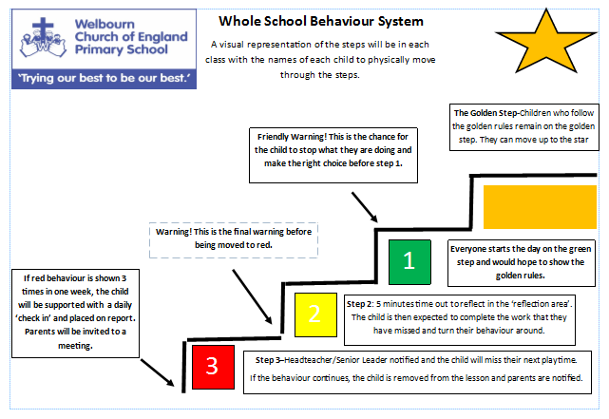
Behaviour policy
Missing playtime
Time to talk about the incident
Time to reflect on the incident
Restorative work (sorry letter etc)
An opportunity to learn new strategies to prevent this from happening again
Follow up

Slide 10
What have we done?
The behaviour system has been reviewed and made consistent
They are displayed and referred to in every class
Children know what each colour means and the consequences for each one
It has been shared and is on the website
School routines week – rules/ expectations
CPOMS online tool to log incidents
Reward systems – team points/ gold star/ stickers/ praise
Playtime aware – all staff monitoring
Impact
Children enjoy receiving ‘Gold star status’
Children are able to see fair consequences
Low level disruption is reduced
Improved monitoring
Increased communication between staff

Slide 11
What’s your view?
Are you aware of the system?
Has your child/ children talked about it?
What do you like about it?
Do you think it is fair?
How could we improve?

Slide 12
Communication
What is working well?
Even better if…

Slide 13
Next steps
Sign up, closed group, open to all?
Minutes, communication with all parents?
Focus?
Format?

