Slide 1
Parent Forum
Good afternoon!
Please take a seat

Slide 2
Expectations
We would like:
Positivity
Honesty
Constructive criticism or review
You to think of the best interests for ALL our children, staff, community
It is not time to:
Make a complaint publicly
Discuss your child’s learning, class, concerns
A place to be negative or confrontational

Slide 3
Our focus today
Curriculum
Ofsted
Parental feedback
Next focus request

Slide 4
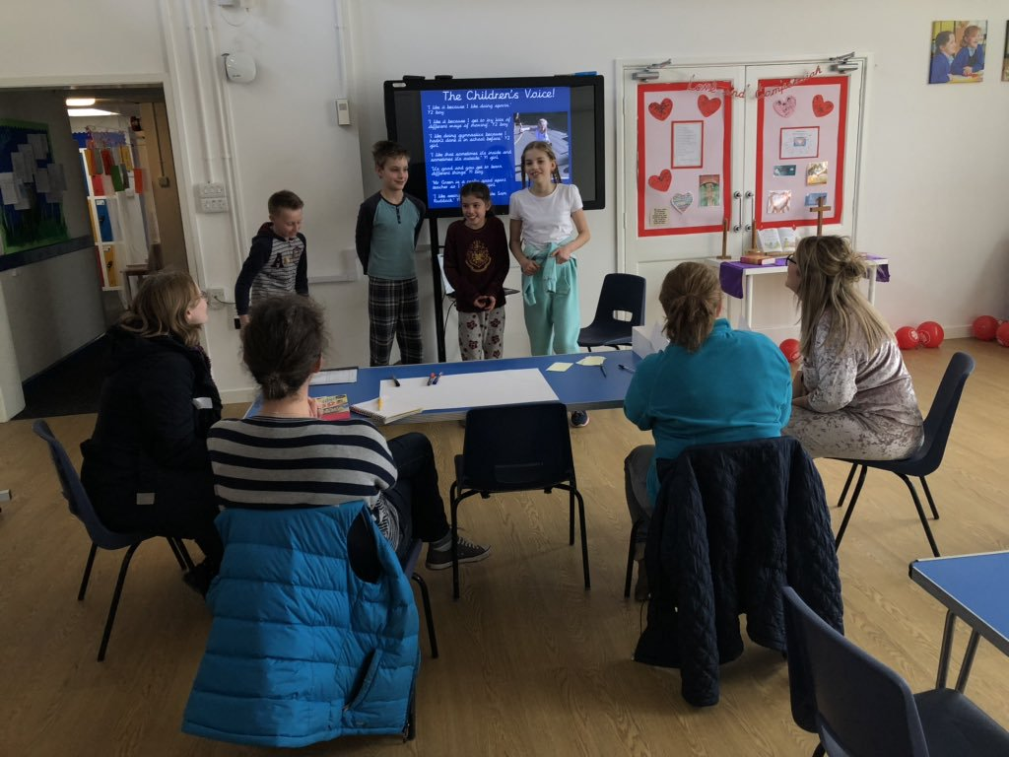
The last time we met…
Miss Hope and the sports ambassadors shared information about our P.E and well being provision in school.

Slide 5
Our journey…
Our ‘Why?’ or intent
What our children need
How they learn best
What Welbourn has to offer
What our children are interested in
What resources we need
What we want for our children ‘Welbourn Wish’

Slide 6
The Curriculum
Our Strapline….
‘Believe, Excite, Succeed, Together’
Curriculum Intent…
Our curriculum aims to provide a breadth of opportunities to instil a love of learning and prepare our unique children for an ever changing modern world.

Slide 7
The Curriculum
Our Vision… At Welbourn C of E Primary School, it is our privilege to nurture and inspire each other to be considerate, hard-working and creative; reaching their full potential in a loving school community. We do this by: Providing a stimulating and enriching curriculum, tailored to meet the needs of all learners Continuously setting high expectations required to strive for personal excellence. Providing nurture and security, reflected in a caring Christian ethos. Affording creative opportunity, enabling children to flourish in art, music and drama. Encouraging teamwork and respect; governors, staff and children working together in our school and wider community. Valuing each individual, ensuring that each child’s unique qualities are developed and they receive the education they deserve. Unlocking the potential in each individual and developing academic skills needed for lifelong learning, including ingenuity, problem-solving and curiosity. Fostering a positive atmosphere in developing essential emotional skills, including aspiration, perseverance, and independence. At the heart of all we do, we strive to make our children’s experiences of primary school enriching, engaging, successful, happy and fun.

Slide 8
We now have…
A progressive curriculum in place for Maths, English, IT and R.E
Topic approached curriculum for all other subjects
Planned trips, visits and visitors
Planned themed days and weeks
Updated the website with our class overviews
Planned links to other subjects
Planned first hand experiences

Slide 9
Our priorities
1. Improve leadership, management and governance of the school by ensuring that: Subject leaders receive the necessary training and time to develop their leadership skills and to monitor the quality of teaching effectively Leaders at all levels, including governors, embed those strategies that they have already put into place to ensure that teachers' assessment of pupils' achievement is accurate There are increased opportunities both within mathematics lessons and the wider curriculum for pupils to develop their mathematical skills, particularly their problem solving and reasoning skills
2. Improve the quality of teaching and the progress made by all pupils, by ensuring that: Assessment information is used effectively when planning pupils' future learning Consistently set activities provide sufficient support and challenge for all pupils, particularly the middle-attaining pupils and the most able to enable them to make at least the progress they should Staff can quickly clarify any misconceptions that pupils may demonstrate in their learning, so that pupils become secure in their knowledge, skills and understanding
3. Raise pupil attainment throughout the school by ensuring that: All assessment data is accurate based on standardised tests, internal tracking and moderation of age related expectations The curriculum is fit for purpose and provides opportunities to use and apply key skills within R, W and M The gap for all pupils between School and National is diminished in all areas for all groups, in particular EYFS, maths whole school and KS1 writing
4. Improve pupils’ personal development, behaviour and welfare by: Working closely with parents to develop and sustain strong relationships, as partners in learning, ensuring attendance and punctuality improves, especially those who are persistently absent Increasing expectations of pupil behaviour in line with school policy and supporting those pupils who require help to develop better self-regulation and management Agreed behaviours for learning are consistently embedded across the school

Slide 10
Priority 1: Improve leadership, management and governance of the school by ensuring that: Good
Subject leaders receive the necessary training and time to develop their leadership skills and to monitor the quality of teaching effectively
Yes, leaders have staff meeting time, time out of class to complete tasks and 1:1 support
Receive termly training
Have presented to Governors and Locality Leaders
Showing an impact on the development of teaching and learning
Monitoring T & L and providing feedback to staff
Leaders at all levels, including governors, embed those strategies that they have already put into place to ensure that teachers' assessment of pupils' achievement is accurate
Termly external support from a National moderator
Pupil progress meetings with Governors present
Pupils achievement is monitored through looking at books, learning walks and data
Subject leaders using data to inform monitoring
There are increased opportunities both within mathematics lessons and the wider curriculum for pupils to develop their mathematical skills, particularly their problem solving and reasoning skills
This is evident in science and some topic lessons but needs to be developed further
Meaningful maths and links need to be planned more frequently

Slide 11
Priority 2: Improve the quality of teaching and the progress made by all pupils, by ensuring that: RI
Assessment information is used effectively when planning pupils' future learning
Staff use pre learning to plan activities and use a range of assessment techniques
Differentiation is in place
Consistently set activities provide sufficient support and challenge for all pupils, particularly the middle-attaining pupils and the most able to enable them to make at least the progress they should
Most children are making good progress
We need to develop challenge and expose more children to using Greater Depth concepts
Staff can quickly clarify any misconceptions that pupils may demonstrate in their learning, so that pupils become secure in their knowledge, skills and understanding
Our new marking and feedback policy is in place to address misconceptions
Misconceptions in maths are planned for
Misconceptions are addressed in lessons or as part of intervention

Slide 12
Priority 3: Raise pupil attainment throughout the school by ensuring that: All assessment data is accurate based on standardised tests, internal tracking and moderation of age related expectations External moderator termly Moderation with the AQT PPA support Pupil progress meetings Pupil tracking The curriculum is fit for purpose and provides opportunities to use and apply key skills within R, W and M Curriculum overviews are in place Staff meetings planned to develop this Development needed to use and apply key skills The gap for all pupils between School and National is diminished in all areas for all groups, in particular EYFS, maths whole school and KS1 writing
Intervention maps Adults used to support children who have fallen behind Booster Tracking

Slide 13
Priority 4: Improve pupils’ personal development, behaviour and welfare by: Working closely with parents to develop and sustain strong relationships, as partners in learning, ensuring attendance and punctuality improves, especially those who are persistently absent Parental engagement mornings or afternoons Parent Forums Parent workshops New policy for attendance and reporting Increasing expectations of pupil behaviour in line with school policy and supporting those pupils who require help to develop better self-regulation and management Behaviour policy embedded Governor review Positive feedback from parents regarding dealing with possible incidents of bullying Intervention to support behaviour Agreed behaviours for learning are consistently embedded across the school Routine weeks Strategies in class to improve independence Visitors comment on how well children behave

Slide 14
Ofsted
Effectiveness of leadership and management (including safeguarding)
Quality of teaching, learning and assessment
Personal development, behaviour and welfare
Outcomes for pupils
Early Years Provision
Overall effectiveness

Slide 15
What do you think?
What positive changes have you seen?
What do you think needs to improve?
What concerns do you have?
Do you have any suggestions?

Slide 16
Next steps
What would you like to discuss?

